Slide 1
Team 20 – Galaxy/Space
Deeti, Zach, Henry, Sera, Oscar

Slide 2

Research board

Slide 3

Distillation

Slide 4
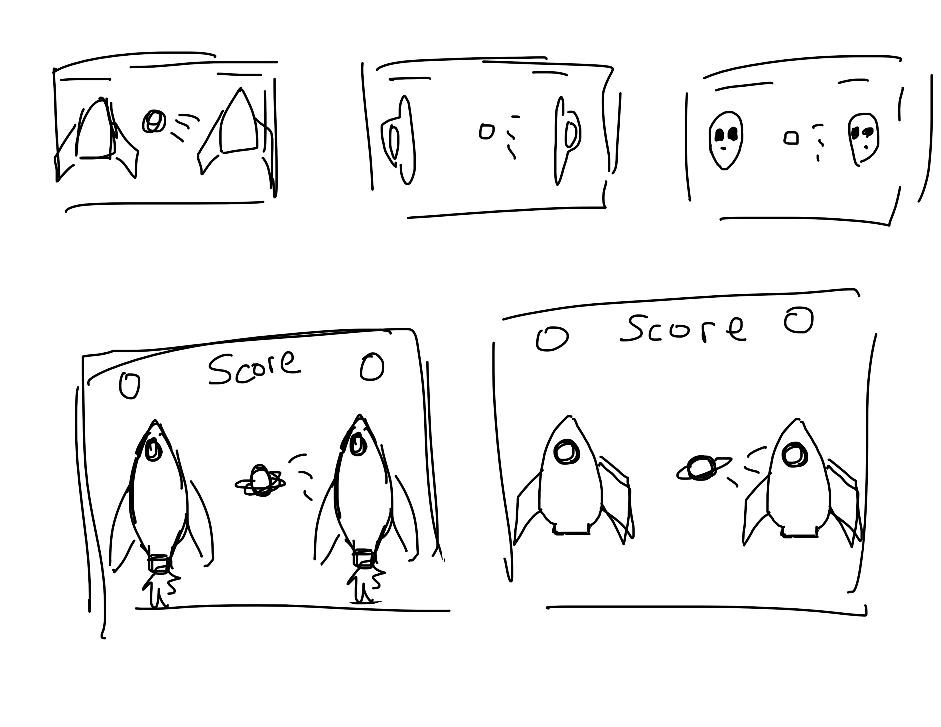
Thumbnails

Slide 5
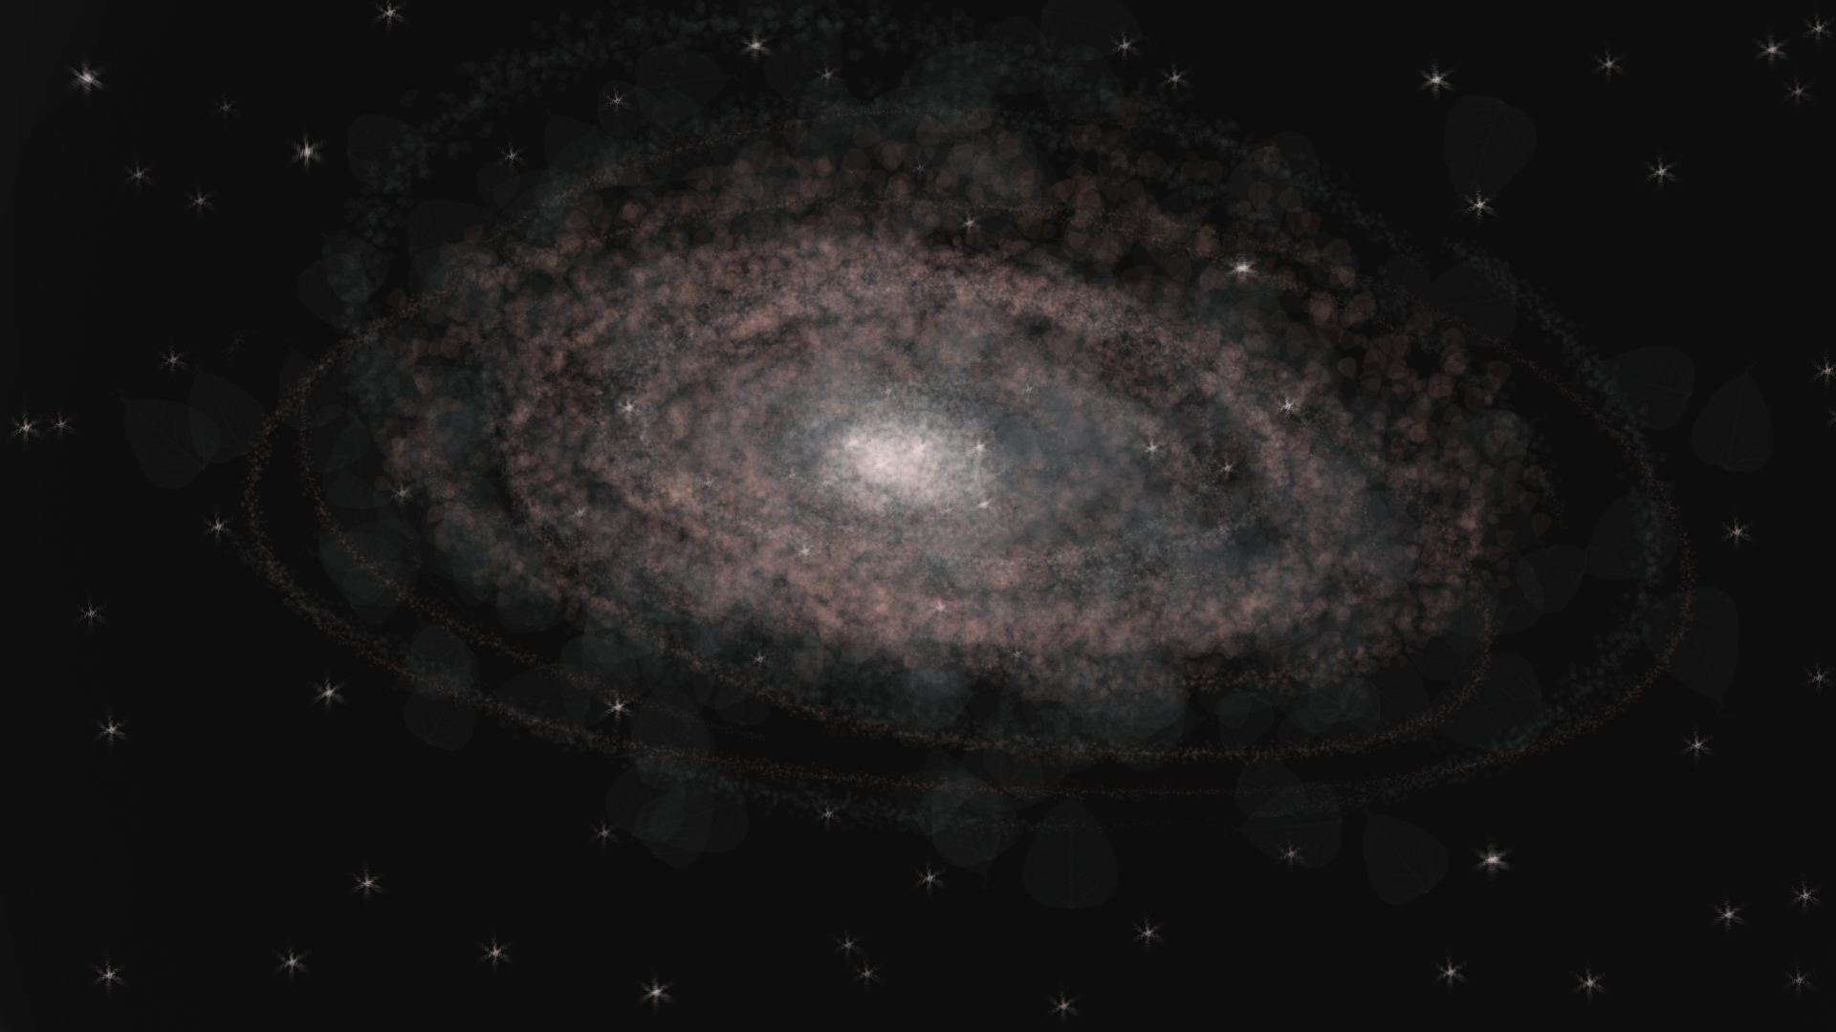


Final art

Slide 6
Screenshot of the game

